Slide 1


The Effect of Spatial-Temporal Scales of Analysis on Regionalization of Extreme Rainfall in India
Presented by
Agami Pramanik
M.Tech
Under the guidance of
Prof. Dr. V.V. Srinivas

Slide 2

Abstract
Regionalization of extreme rainfall refers to the delineation of an area into several regions homogeneous in extreme rainfall characteristics. In this study, regionalization analysis was repeated considering four different spatial resolutions (0.12°, 0.25°, 0.50°, and 1.00°) and seven temporal resolutions (1, 2, 3, 4, 5, 6 hours, and 1-day). Competitive agglomeration, a fuzzy clustering method, is used to determine the optimal number of homogeneous regions in India. Extreme rainfall quantiles were estimated corresponding to different temporal resolutions and specified non-exceedance probability in a non-stationary framework by fitting non-stationary regional frequency distribution.

Slide 3


Content
Introduction & Literature Review
Theoretical Background
Methodology
Results
Conclusion

Slide 4
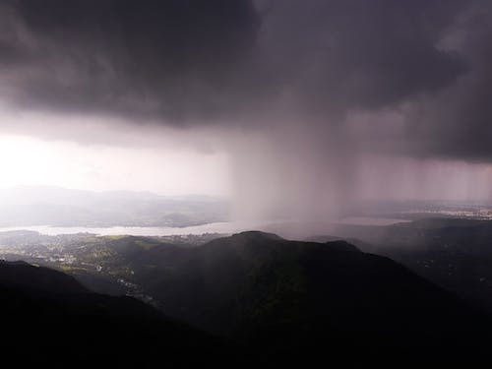
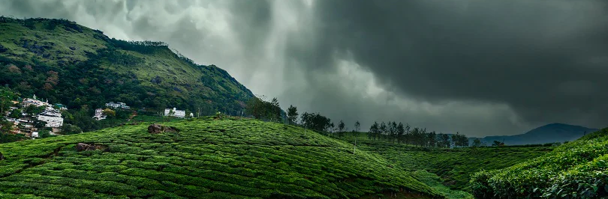
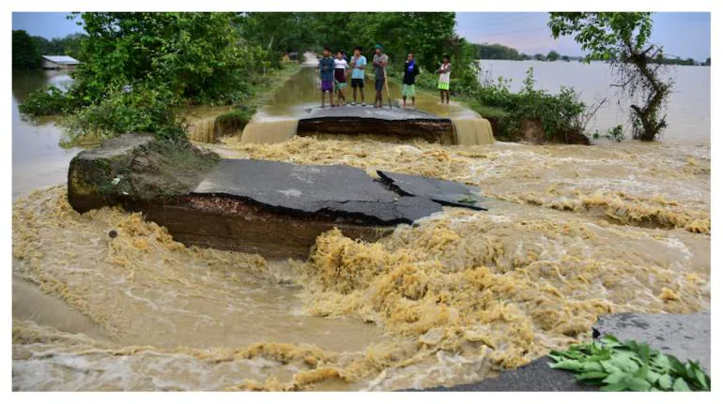
Introduction & Literature review

Slide 5

Why do we Need Regionalization of extreme rainfall?
Regionalization of rainfall refers to delineating a large area into several regions homogeneous in rainfall related characteristics. The delineated regions facilitate the pooling of extreme rainfall-related information from various gauged locations to obtain effective quantiles and design hyetographs corresponding to different non-exceedance probabilities at sparsely gauged and ungauged locations. The design hyetographs find use in studies related to landslides in hilly regions. Furthermore, design floods derived corresponding to those hyetographs are necessary for flood risk analysis at various hot spots in river basins, including large-scale flood control and conveyance infrastructure (e.g., dams, barrages/bridges, levees, culverts, weirs), and in land use planning and management. and there are concerns about the safety of several (∼20% of 5300) dams in the country as they would be over 50 years old by 2025. Against this backdrop, investigations are necessary to derive effective homogeneous extreme rainfall regions in the country to facilitate effective risk analysis

Slide 6
Objectives
To identify homogeneous extreme rainfall regions in India for four different spatial resolutions (0.12º, 0.25º, 0.50º, and 1.00º) and seven different temporal resolutions (1, 2, 3, 4, 5, 6 hours, and 1-day). Further, to investigate the effect of the spatial-temporal resolutions on regionalization of extreme rainfall.
To assess the effect of non-stationarity in hourly rainfall data on quantile estimates of extreme rainfall corresponding to a specific non-exceedance probability by comparing them with their stationary counterpart.
To estimate flood (peak flow) at Sondur dam in the frequent flood prone Mahanadi basin using the quantile estimates obtained from non-stationary regional frequency analysis and quantify the change in peak flood values obtained in non-stationary and stationary framework.
Notes:
Hi I

Slide 7
Literature Review
Papers | Method used for regionalization
Satyanarayana and Srinivas, 2008 | Regional frequency analysis
Cooley et al., 2007; Cooley and Sain, 2010 | Bayesian spatial modelling
Blanchet and Lehning, 2010; Panthou et al., 2012 | Spatial maximum likelihood estimation (SMLE) approach
Haddad et al., 2011 | Regression analysis based approach
Sveinsson et al., 2002; Szolgay et al., 2009 | Regional rainfall frequency analysis
Bharath and Srinivas, 2014 | Global fuzzy c-means (GFCM)

Slide 8
THEORETICAL BACKGROUND

Slide 9

ATTRIBUTES
Latitude
Longitude
Distance from the Sea
Elevation from the Mean Sea Level (MSL)
L-Mean
Coefficient of L variation (L-CV)
L-Skew
L-Kurtosis
L-Statics
Location Attributes

Slide 10
Competitive Agglomeration
Competitive Agglomeration (CA) is an fuzzy algorithm used to make clusters of different shapes in machine learning. The algorithm aims to group similar data points into clusters.
Initially, it creates a large number of small clusters. As the algorithm proceeds, these clusters compete for data points, the clusters which lose the competition vanish, and the optimum number of clusters is reached.
Here, the effect of initialization is very less compared to the other traditional clustering methods, and premature commitment to a particular cluster is also avoided.
Notes:
Hosking introduced them in the 1990s as an alternative to the traditional moments of distribution.

Slide 11
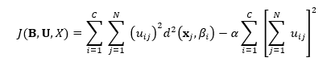

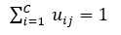
Competitive Agglomeration (contd.)
Objective function of CA:
min
Subject to: for j=1,…, N
The first component of equation enables us to regulate the shape and size of clusters, leading to more condensed groups. The second component, on the other hand, governs the number of clusters.
By combining both components and selecting α appropriately, the final cluster arrangement minimizes the sum of intra-cluster distances while dividing the data into the smallest number of clusters possible.
Notes:
Lagrange Multiplier

Slide 12
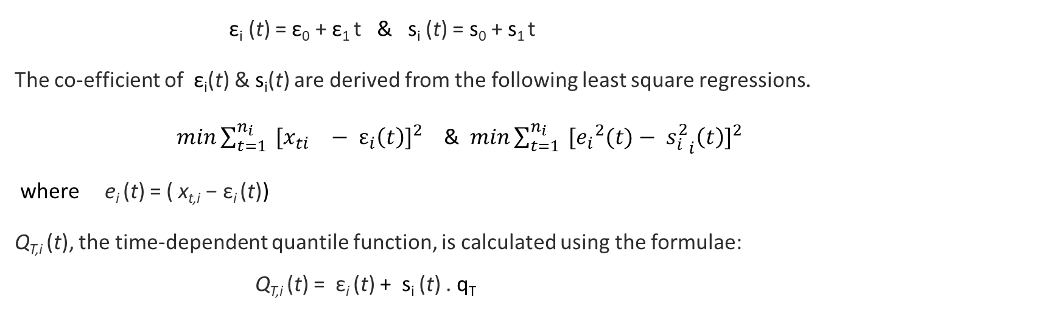
Non-Stationary regional frequency analysis (NS-RFA) & Non-stationary index flood method (NS-IF)
The hourly rainfall data was found non-stationary using Augmented Dickey-Fuller (ADF) test.
Therefore, to calculate rainfall quantiles NS-IF method is applied which is a more adaptable version of NS-RFA. When the first two statistical moments of at-site data are assumed to be nonstationary mean and standard deviation are expressed as a linear function of time.
ε_{i} (t) = ε₀ + ε₁ t & s_{i} (t) = s₀ + s₁ t
The co-efficient of ε_{i}(t) & s_{i}(t) are derived from the following least square regressions.
$min{\sum_{t=1}^{n_{i}}{ }[{x_{ti}}^{}− ε_{i}\left(t\right)]}^{2}$ & $min{\sum_{t=1}^{n_{i}}{ }[{e_{i}}^{2}(t)− {s_{i}^{2}}_{i}\left(t\right)]}^{2}$
where e_{i} (t) = ( x_{t,i} − ε_{i} (t))
Q_{T,i} (t), the time-dependent quantile function, is calculated using the formulae:
Q_{T,i} (t) = ε_{i} (t) + s_{i} (t) . q_{T}
(q_{T}) was calculated assuming the standardized data follow regional GEV distribution.
Notes:
Lagrange Multiplier

Slide 13
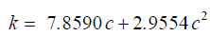
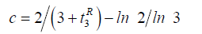
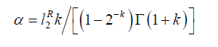
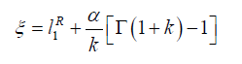
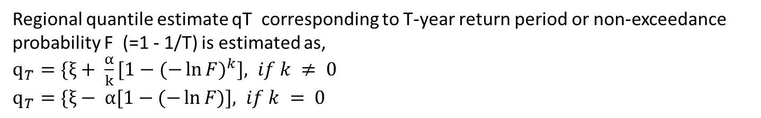
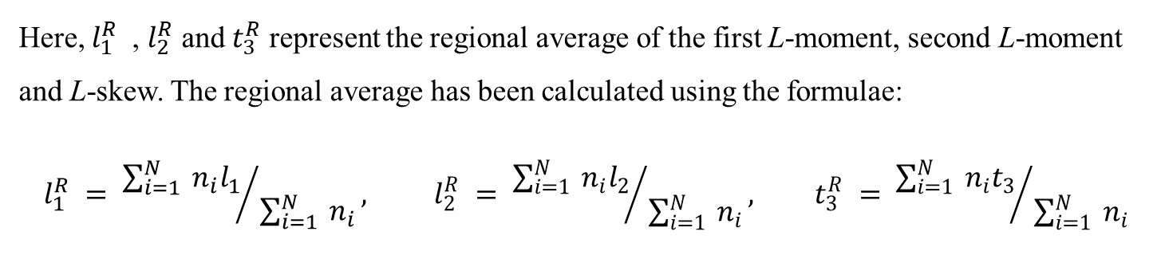
Regional L-Moments & GEV Distribution
The regional GEV distribution is one of the most used distributions in RFA for extreme events. It may be described by three parameters: location (ξ), scale (α), and shape (k). Equations for calculating the parameters are:
Here, $l_{1}^{R}$ , $l_{2}^{R}$ and $t_{3}^{R}$ represent the regional average of the first L-moment, second L-moment and L-skew. The regional average has been calculated using the formulae:
$$l_{1}^{R} = {\sum_{i=1}^{N}{ }n_{i}l_{1}}/{ \sum_{i=1}^{N}{ }n_{i}}, l_{2}^{R} = {\sum_{i=1}^{N}{ }n_{i}l_{2}}/{ \sum_{i=1}^{N}{ }n_{i}}, t_{3}^{R} = {\sum_{i=1}^{N}{ }n_{i}t_{3}}/{ \sum_{i=1}^{N}{ }n_{i}}$$
Regional quantile estimate qT corresponding to T-year return period or non-exceedance probability F (=1 - 1/T) is estimated as,
$q_{T}=\{ξ+ \frac{α}{k}[1−{(−\ln{F)}}^{k}], if k ≠ 0$
$q_{T}=\{ξ− α[1−(−\ln{F)}], if k = 0$

Slide 14
methodology

Slide 15

PROCESS MAP (Spatial & temporal analysis)
Data Collection
The daily rainfall data were extracted for the 0.25º resolution grids from the IMD from 1901 to 2019. Finer resolution (0.12º) hourly rainfall data was obtained from IMDAA project from 1989 to 2018 (April – October).
Data Processing
Hourly rainfall data was subsequently aggregated to calculate 2-hour to 6-hour rainfall data. Calculation of annual maximum rainfall series for all datasets for all the grid points in India. L-moment ratios were calculated for all grid points.
Re-griding ( For Spatial Analysis)
0.25º gridded rainfall data were re-gridded using the biharmonic spline interpolation technique to arrive at annual maximum rainfall values corresponding to 0.50º and 1.00º resolutions.
Elevation & Distance from Sea
Both parameters are calculated using tools available in QGIS using the Digital Elevation Model (DEM) and shapefiles of India.
Competitive Agglomeration (CA) is used for fuzzy clustering with normalized attribute values. Homogeneity of the regions corresponding to each grid size is checked using heterogeneity measure.
Clustering & Homogeneity Test
Notes:
IMDAA - Indian Monsoon Data Assimilation and Analysis (IMDAA) project

Slide 16
PROCESS MAP (Temporal analysis)
Estimation of quantiles
Time-dependent rainfall quantile estimates were calculated with a Return Period of 60,000 years. Regional GEV distribution was selected as the underlying distribution for NS-RFA for all the temporal resolutions.
Calculation of TD coefficients
The median rainfall quantiles were computed over each region. These median rainfall quantiles were used to find area-weighted rainfall for the study area (i.e., upper & middle Mahanadi basin) and TD coefficients were estimated.
Catchment Delineation
Sondur dam catchment was selected for the flood analysis. The dam catchment was delineated, and physiographical parameters were calculated using ArcGIS.
Calculation of SUH
CWC method was used for estimating the SUH. UH parameters were calculated using the equations provided in Flood analysis report of Mahanadi basin 3(d) (1997). The estimated SUH was smoothened so that area under the curve becomes unity.
PMP was estimated for the dam catchment area using PMP atlas which provides estimates in stationary framework. Flood hydrographs were generated using SUH and the effect non-stationarity was identified.
Comparison of hydrographs

Slide 17
Results & Discussion

Slide 18
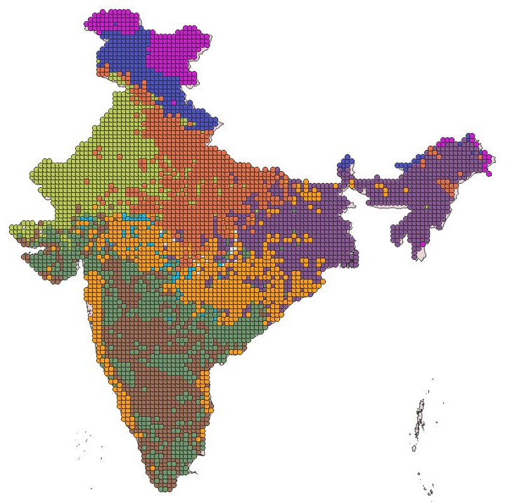
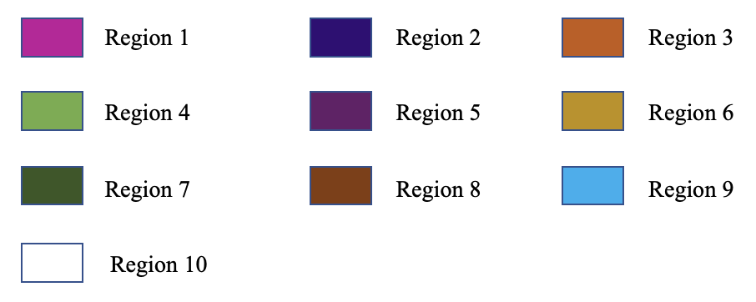
Extreme rainfall regions formed using 0.25º gridded rainfall data
Clusters are converted from attribute space to geographical space and plotted on the India map to visualize their distribution properly.
Total 10 regions are formed using CA clustering.

Slide 19
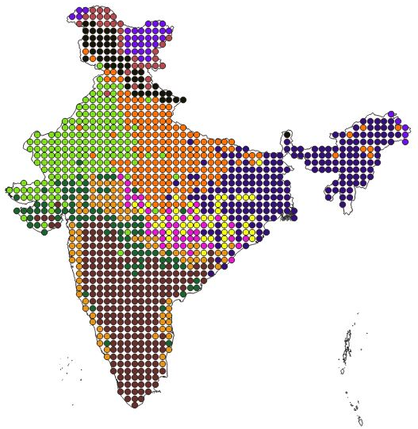
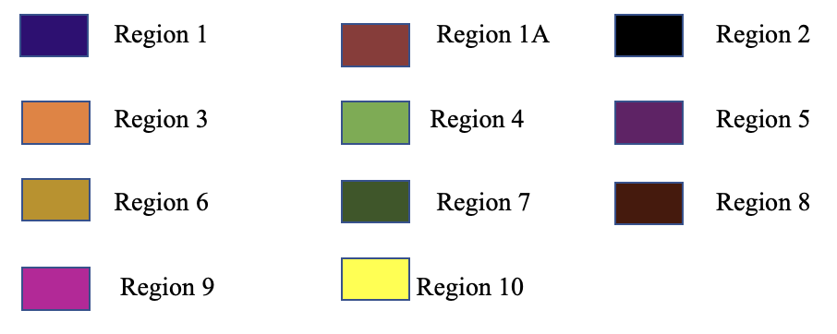
Extreme rainfall regions formed using 0.50º gridded rainfall data
Clusters are converted from attribute space to geographical space and plotted on the India map to visualize their distribution properly.
Total 11 regions are formed using CA clustering.

Slide 20
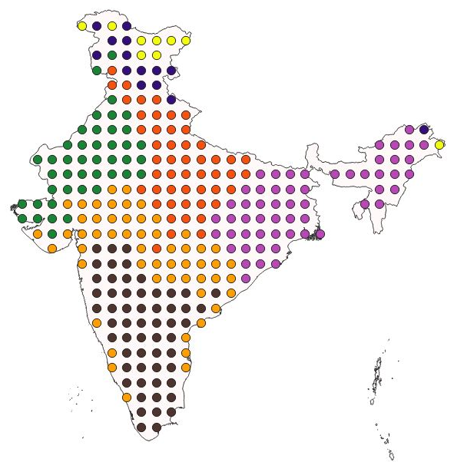
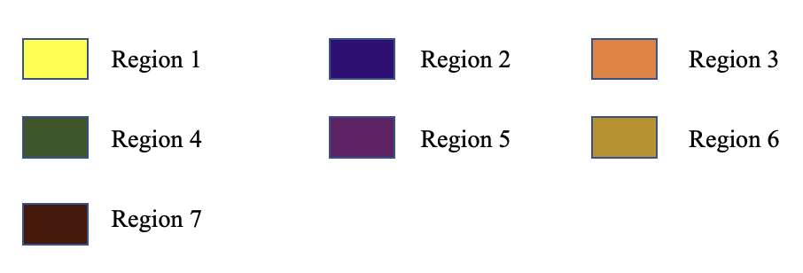
Extreme rainfall regions formed using 1.00º gridded rainfall data
Clusters are converted from attribute space to geographical space and plotted on the India map to visualize their distribution properly.
Total 7 regions are formed using CA clustering.

Slide 21
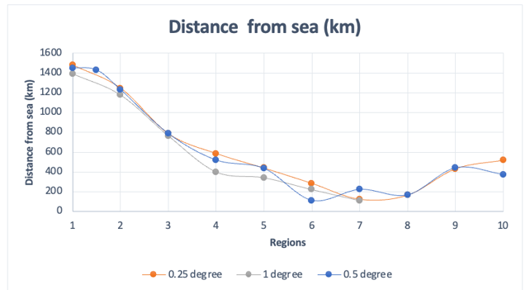
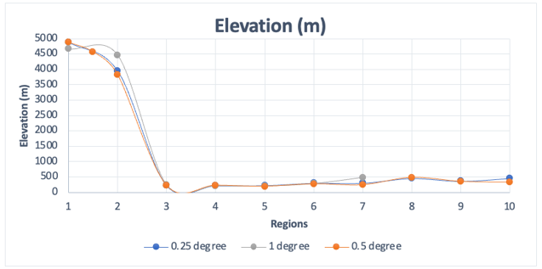
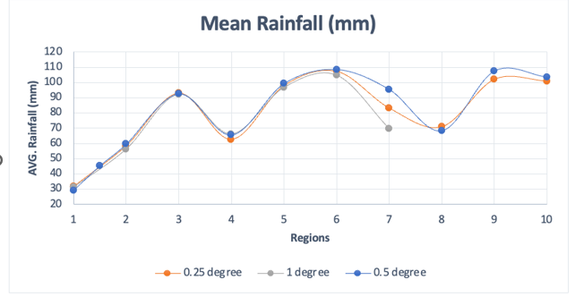
Variation of attributes across all the regions for gridded rainfall data of different spatial resolution
From the plots which show the variation of attributes corresponding to different spatial resolutions for co-registered regions, it implies that the median value of average rainfall remains same upto region 6 but small variation is there from region 7 to10, which consists of the Southern part of India. Minor variation exists for other attributes as well.

Slide 22
From Heterogeneity Measure (Spatial Analysis)
Grid Size | 1 | 1A | 2 | 3 | 4 | 5 | 6 | 7 | 8 | 9 | 10
1.00º | 5.35 | - | 1.35 | 1.01 | 2.87 | 0.76 | 0.29 | -0.2 | - | - | -
0.50º | 5.21 | 3.71 | 0.83 | 1.84 | 2.16 | 5.67 | 4.77 | 3.38 | 1.21 | -0.5 | 0.01
0.25º | 22 | - | 6.58 | 3.15 | 5.48 | 12.37 | 4.2 | 3.28 | 5.73 | 2.99 | 0.31
For rainfall measurements, coarser spatial resolution averages smaller-scale variations, decreasing sensitivity and making it harder to detect differences between regions. This decreases the H value of heterogeneity with coarser resolution.

Slide 23
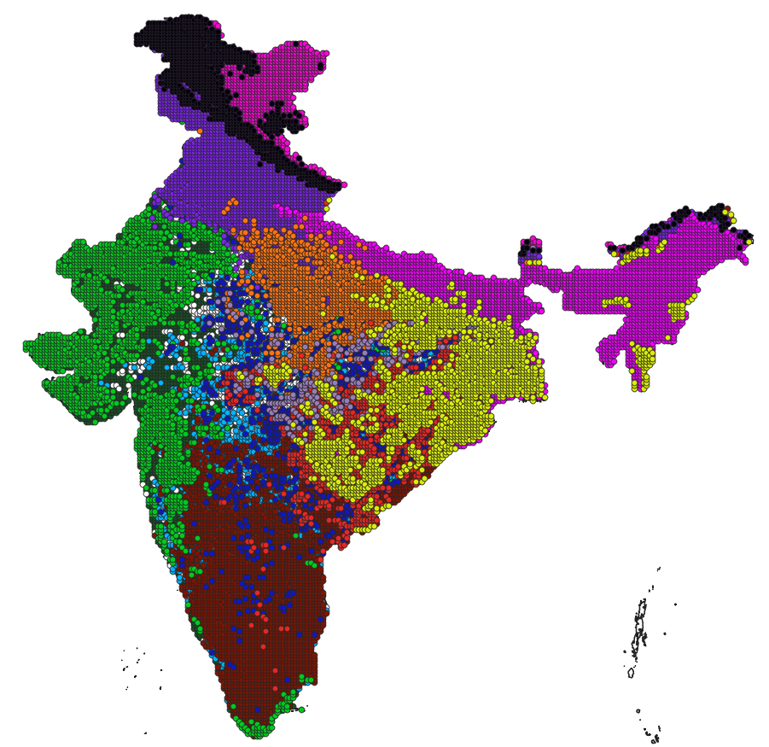
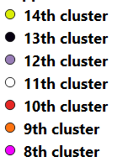
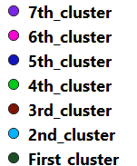
Extreme rainfall regions formed using 0.12º gridded 1-hour rainfall data
Clusters are converted from attribute space to geographical space and plotted on the India map to visualize their distribution properly.
Total 14 regions are formed using CA clustering.

Slide 24
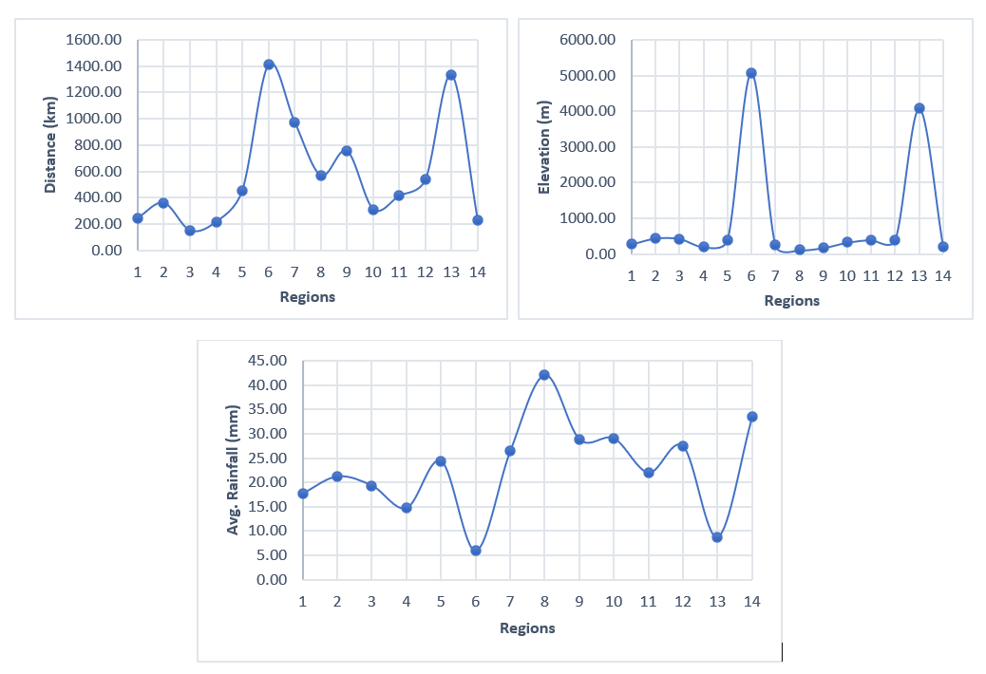
Variation of median values of attributes across different homogeneous extreme rainfall regions formed using 0.12º gridded 1-hour rainfall data.

Slide 25
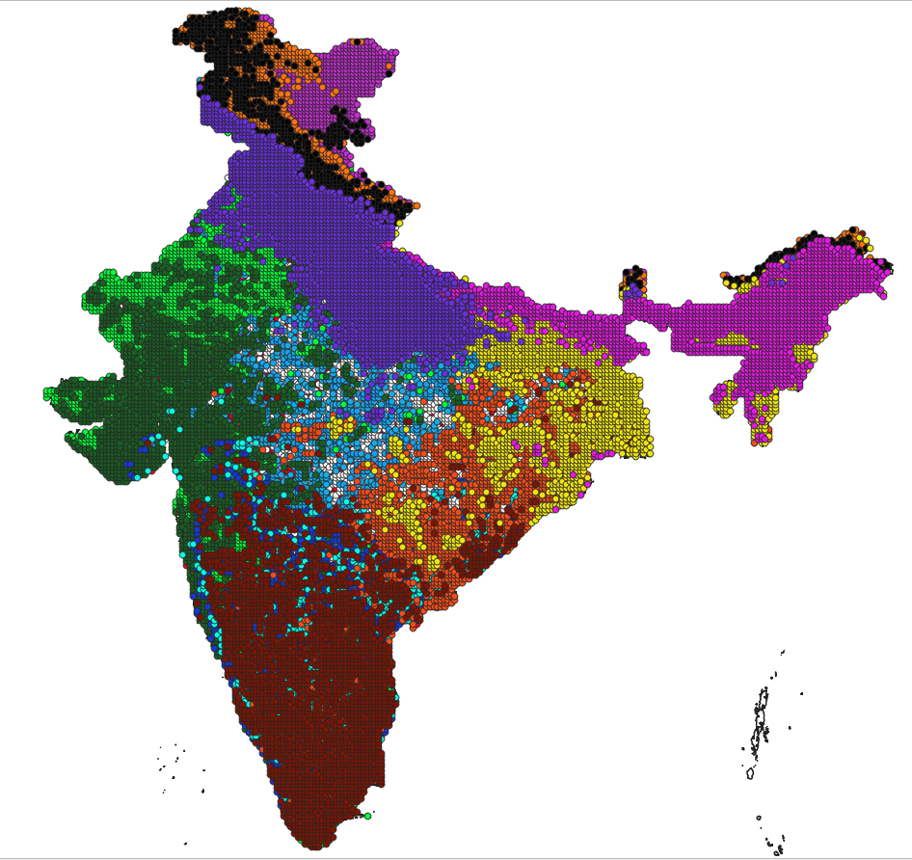
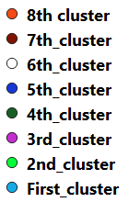
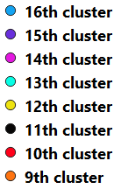
Extreme rainfall regions formed using 0.12º gridded 2-hour rainfall data
Clusters are converted from attribute space to geographical space and plotted on the India map to visualize their distribution properly.
Total 16 regions are formed using CA clustering.

Slide 26
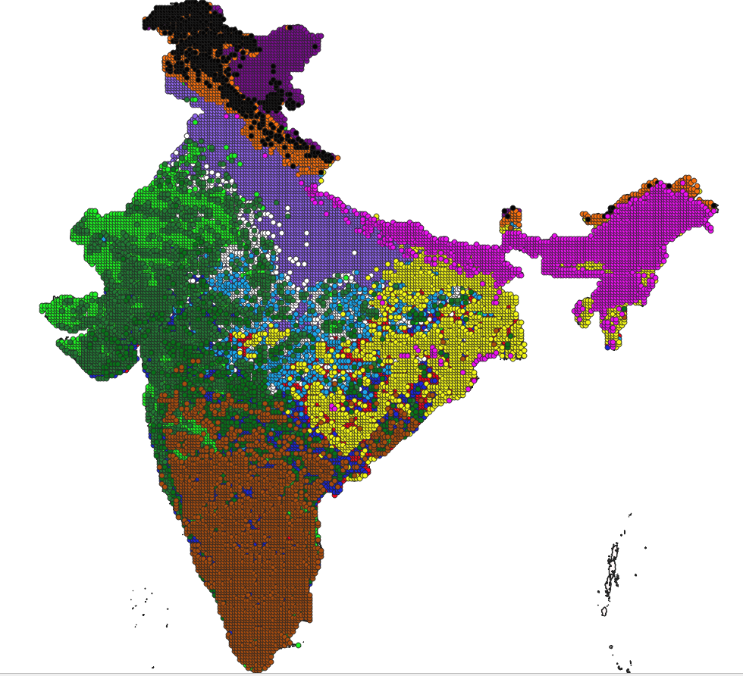
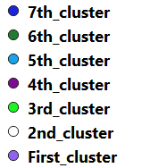
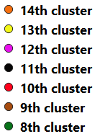
Extreme rainfall regions formed using 0.12º gridded 3-hour rainfall data
Clusters are converted from attribute space to geographical space and plotted on the India map to visualize their distribution properly.
Total 14 regions are formed using CA clustering.

Slide 27
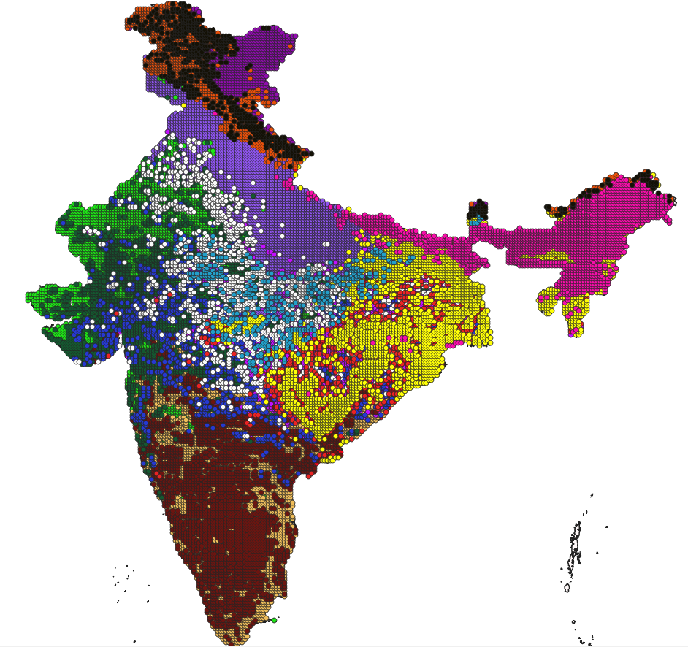
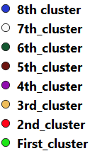
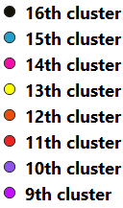
Extreme rainfall regions formed using 0.12º gridded 4-hour rainfall data
Clusters are converted from attribute space to geographical space and plotted on the India map to visualize their distribution properly.
Total 16 regions are formed using CA clustering.

Slide 28
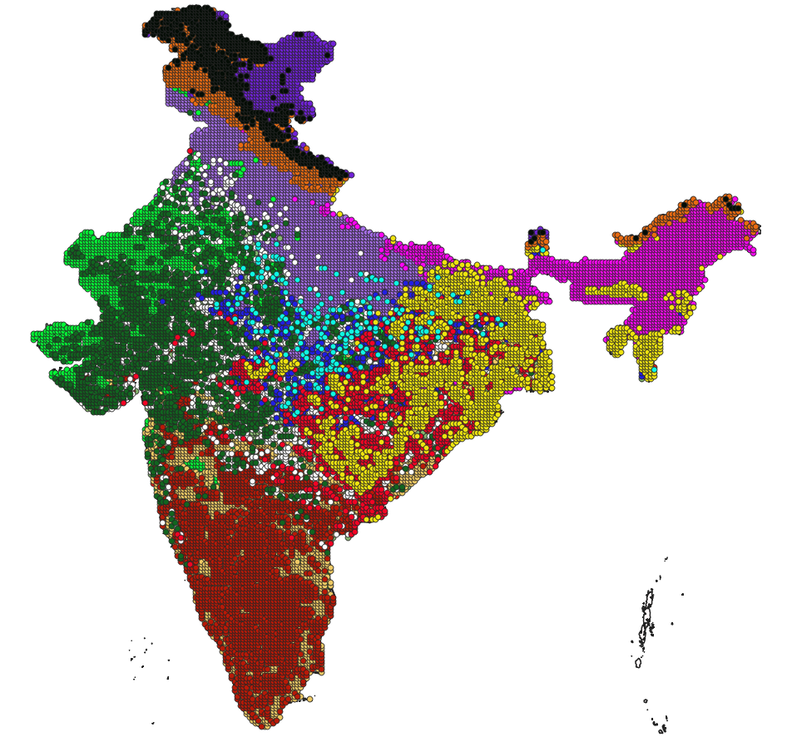
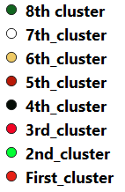
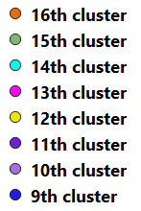
Extreme rainfall regions formed using 0.12º gridded 5-hour rainfall data
Clusters are converted from attribute space to geographical space and plotted on the India map to visualize their distribution properly.
Total 16 regions are formed using CA clustering.

Slide 29
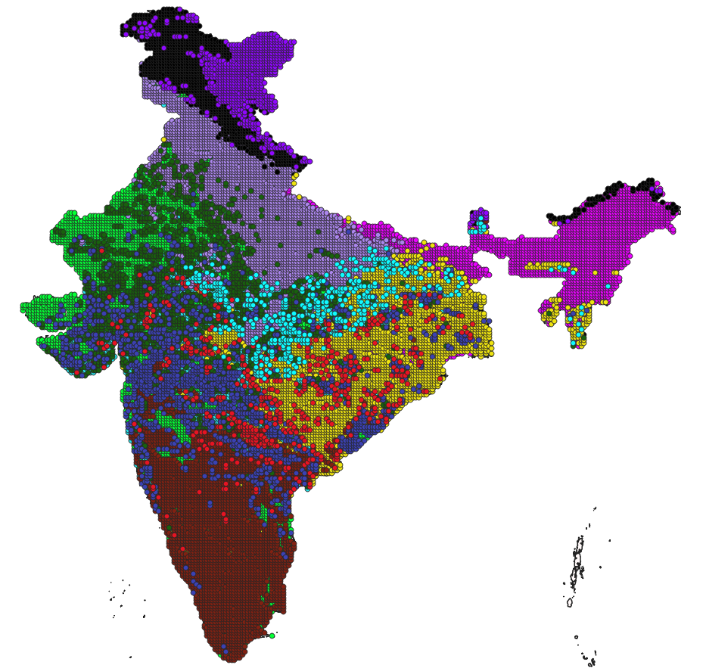
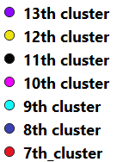
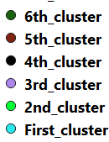
Extreme rainfall regions formed using 0.12º gridded 6-hour rainfall data
Clusters are converted from attribute space to geographical space and plotted on the India map to visualize their distribution properly.
Total 13 regions are formed using CA clustering.

Slide 30
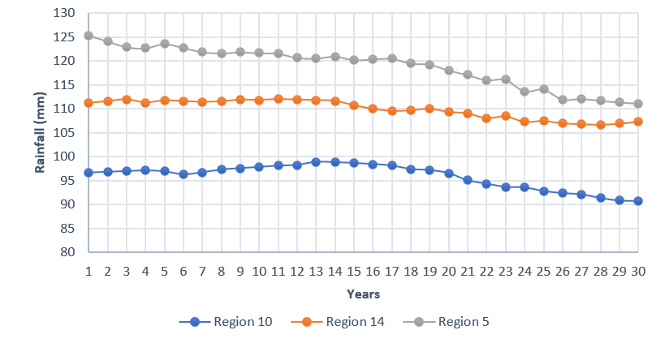
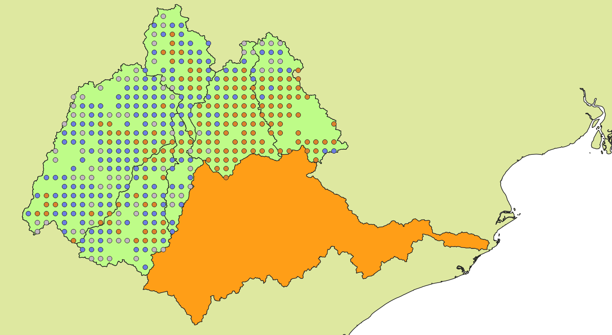
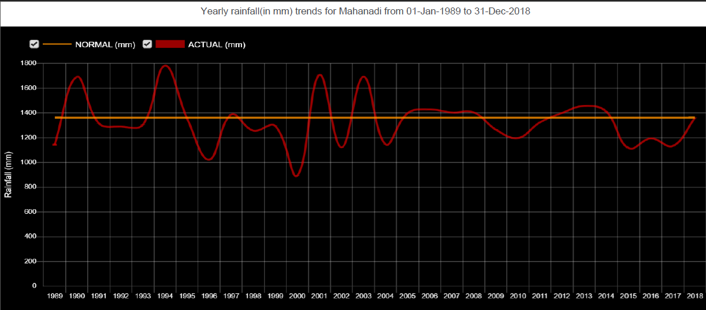

Quantile estimates Three different regions (10, 14 and 5) at upper and middle Mahanadi basin using 0.12º gridded 1-hour rainfall data

Slide 31
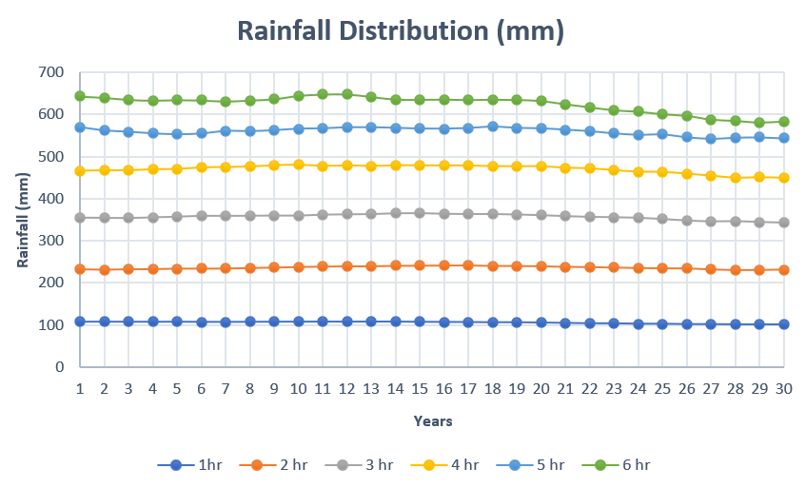
Area Weighted rainfall (1-hour – 6-hour) at upper and middle Mahanadi basin (1989-2018)

Slide 32
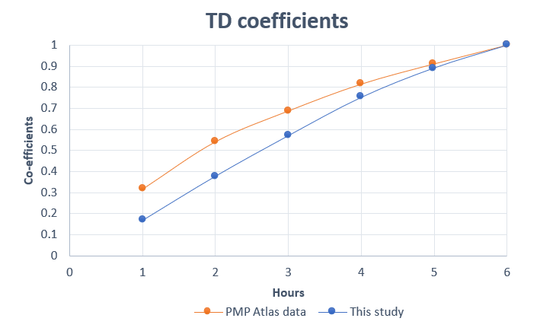
Time Distribution (TD) coefficients at the upper and middle Mahanadi basin
TD coefficients are calculated from the rainfall distribution curves and compared with the 6-hour coefficient derived from the TD coefficients of 12-hour rainfall available from the PMP atlas of CWC for catchment 319.

Slide 33
Rainfall hyetograph at the upper and middle Mahanadi basin
Rainfall hyetograph for the year 1989
Rainfall Hyetograph for the year 2017
For the year 1989 (i.e., first year) a total 6-hour rainfall of 640 mm is noted.
Similarly, for the year 2017 (i.e., penultimate year) a total 6-hour rainfall of 580 mm was noted
One-day PMP of Sondur catchment is estimated as 540 mm. The hyetograph is calculated assuming 80% of the rainfall happens in the first 6 hours.
Rainfall Hyetograph of estimated from PMP atlas

Slide 34
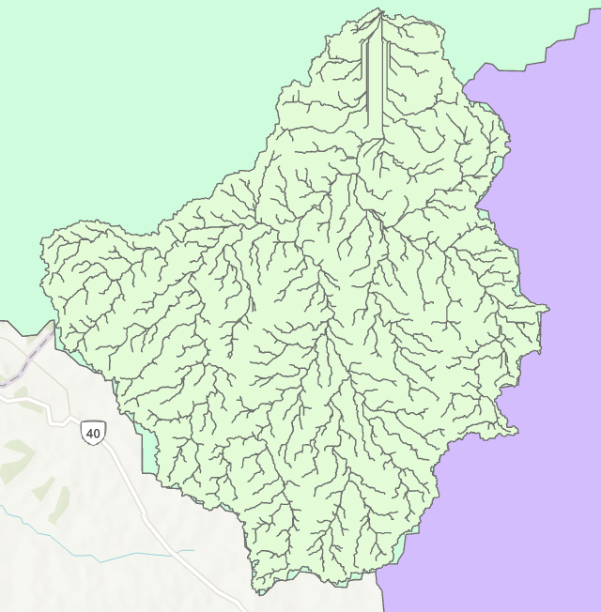
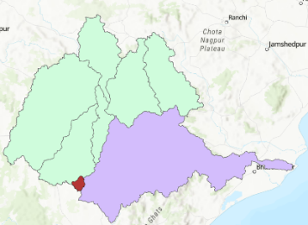
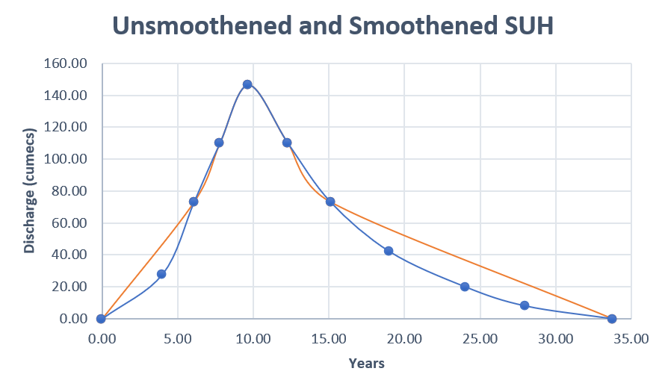
Synthetic unit hydrograph (SUH) of sondur dam catchment
Parameters of SUH were calculated using the physiographic parameters of the Sondur dam catchment using CWC Flood Analysis report of Mahanadi basin.

Slide 35
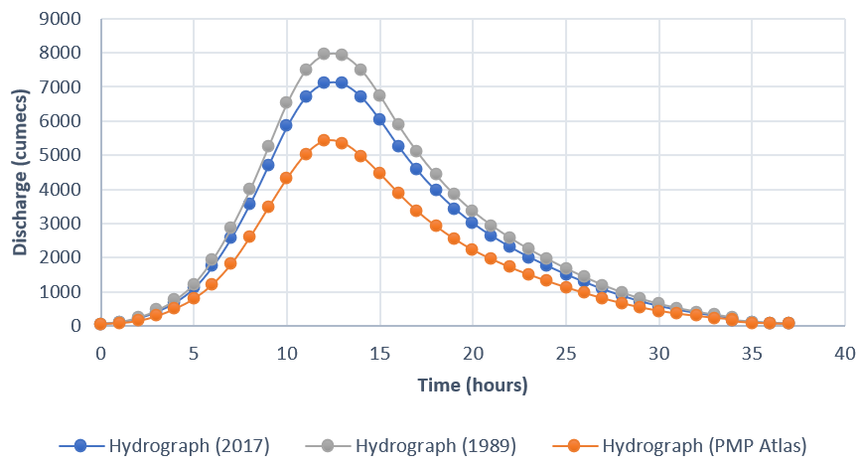
Flood hydrographs of Sondur dam catchment in the Mahanadi basin

Slide 36
Conclusions

Slide 37
From Visualization of regions (Spatial Analysis)
The regions delineated in the northern half of India largely remained the same when the grid size was increased from 0.25º to 1.00º. However, the geographical contiguity of regions formed over south India increased with a decrease in spatial resolution of rainfall.
Each of the delineated regions was tested for statistical homogeneity. In general, the value of the regional heterogeneity measure increased with a decrease in spatial resolution of grids.
Region 1 covering Ladakh and Northern Kashmir union territories and Region 4 located in Rajasthan state are heterogeneous. Those regions are sparsely gauged. Hence adequate number of stations from those regions were not utilized to prepare the gridded data product utilized for regionalization in this study.

Slide 38
Conclusion from temporal analysis
The results showed that the 6-hour PMP estimate derived for the Sondur dam catchment from the Mahanadi River basin’s PMP atlas is underestimated when compared to that derived using non-stationary analysis. The extreme rainfall quantile estimated using non-stationary analysis exceeded the stationary PMP estimate (derived from the PMP Atlas) by 40%. The results indicate that it is quintessential to have a re-look at the PMP atlas in use by CWC for its effectiveness over the entire India and revise it, as the use of incorrect/stationary PMP estimates and TD coefficients have adverse implications.
The same methodology can be applied to calculate the PMP, TD coefficients and peak flow of other river basins or dam catchments. The results obtained from the non-stationary analysis can be compared with their stationary counterpart from PMP atlas to check the variation in values for other catchments as well in India. This way a through revision the PMP Atlas in use by CWC is possible which will benefit the design of hydraulic structures and drainage structures in future.

Slide 39
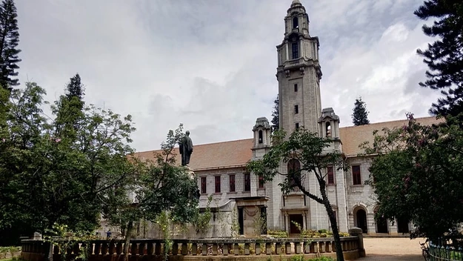
Thank you

Slide 40




Competitive agglomeration

Slide 41

Biharmonic Spline Interpolation Technique
A biharmonic spline interpolation is an interpolation of irregularly spaced two-dimensional data points. The interpolating surface is a linear combination of Green functions centered at each data point. The amplitudes of the Green functions are found by solving a linear system of equations.
it is more flexible than the spline method since both slopes and values can be used to find a surface. Moreover, noisy data can be fit in a least squares sense by reducing the number of model parameters.
When this Green function is used to interpolate N data points, wi, located at xi the problem is
Notes:
Hi I

Slide 42



Biharmonic Spline Interpolation Technique
Where is the biharmonic operator and x is a position in the m-dimensional space. The general solution is
The αj's are found by solving the linear system
Once the αj's are determined, the biharmonic function w(x) can be evaluated at any point using equation above.
Notes:
Hi I

Slide 43
NS-IF
In the case that nonstationarity of the statistical characteristics at each site is considered, the time-dependent site-specific scaling factor can be applied to the IF method. In other words, after the trend observed in the original at-site data is removed by the time-dependent site-specific scaling factor, q_{T} is estimated using the detrended data. When the first two statistical moments of at-site data are assumed to be nonstationary (e.g., Cunderlik and Burn, 2003; Markiewicz et al., 2006a), the time-dependent mean (ε_{i}(t)) and standardized deviation (s_{i}(t)) at site i can be defined as a linear function,

Slide 44
ADF Test
The ADF test is widely used to check stationarity in data. It is based on the idea of testing for a unit root in an autoregressive model of the data. The null hypothesis of the ADF test is that the data is non-stationary or has a unit root. The alternative hypothesis is that the data is stationary or has no unit root. If the test statistic is less than the critical value, we reject the null hypothesis and conclude that the data is stationary. If the test statistic is greater than or equal to the critical value, we fail to reject the null hypothesis and conclude that the data is non-stationary.
The ADF test is based on the following model equation:
The ADF test statistic is given by:
TS = γ’ / SE (γ’)

